Slide 1

Towards Improving Deep Embedded Document Clustering with long range text semantics and neighborhood documents information
National University of Computer and Emerging Sciences
MS Thesis-I Defense & Thesis-II Proposal
Author: S M Imran Abbas (24K-8021)
Supervisor: Dr. Muhammad Rafi
13th May 2026

Slide 2
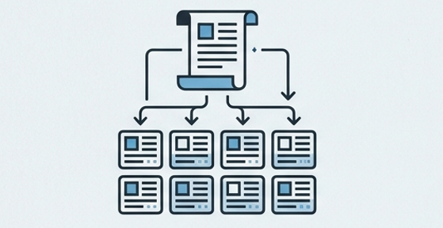
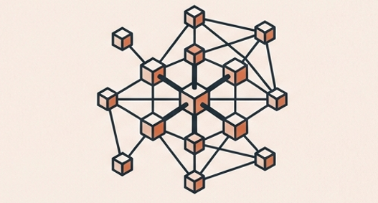
Introduction & Background
Current frameworks rely on two fundamental but distinct pillars to shift from two-stage clustering to unified optimization.
Pillar 1: Semantic Representation
Driven by: Transformers (e.g., BERT, SBERT)
Function: Capturing long-range contextual dependencies and meaning within the text.
Focus: The ‘What’
Pillar 2: Structural Relationships
Driven by: Graph Convolutional Networks (GCNs)
Function: Mapping global neighborhood relationships using K-Nearest Neighbor (KNN) graphs.
Focus: The 'How They Connect'

Slide 3
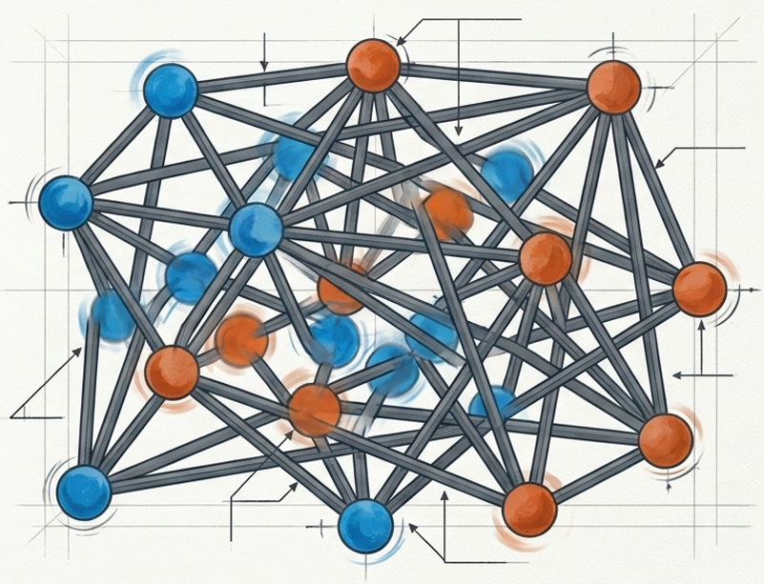
Problems
Failure 1: Semantic-Structural Misalignment
Models optimize both views simultaneously, but lack explicit mechanisms to enforce consistency. The structural topology and the semantic meaning drift apart.
Failure 2: Static Structural Assumptions
Graph-based clustering heavily relies on fixed graphs constructed early. As semantic embeddings evolve during training, rigid connections introduce noise and fail to adapt.

Slide 4

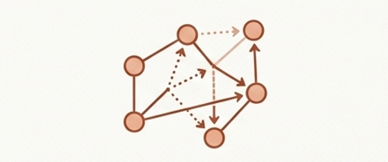
Research Objectives
Unified Goal: Semantically Consistent, Structurally Robust Clustering
Objective 1: Semantic Refinement
Obtain long-range semantic representations using a Transformer encoder to continuously improve the understanding of document content during training.
Objective 2: Adaptive Structural Modeling
Utilize neighborhood structural information via dynamically reconstructed graphs and GCN modeling to guide cluster refinement dynamically.

Slide 5
Literature Review
Model | Deep Semantics (Transformers) | Structural Topology (GCNs) | Dynamics Graphs Updating | Cross-View Contrastive Alignment | Unified Joint Optimization
IDEC [11] | ❌ | ❌ | ❌ | ❌ | ✔️
VaDE [12] | ❌ | ❌ | ❌ | ❌ | ✔️
SDCN [1] | ❌ | ✔️ | ❌ | ❌ | ✔️
DTSN [5] | ✔️ | ✔️ | ❌ | ❌ | ✔️
DACL+ [10] | ✔️ | ❌ | ❌ | ✔️ | ❌
Proposed Method | ✔️ | ✔️ | ✔️ | ✔️ | ✔️
Research Gap: Literature confirms existing SOTA models remain highly vulnerable to initial graph quality and lack adaptive architectural alignment.

Slide 6
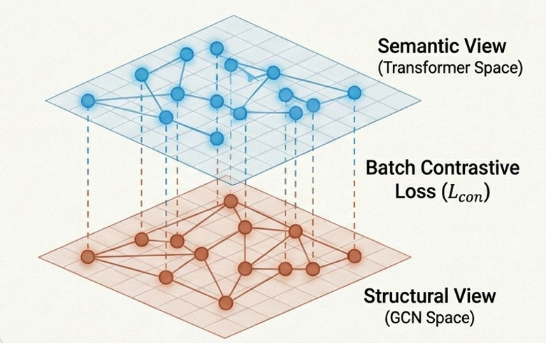
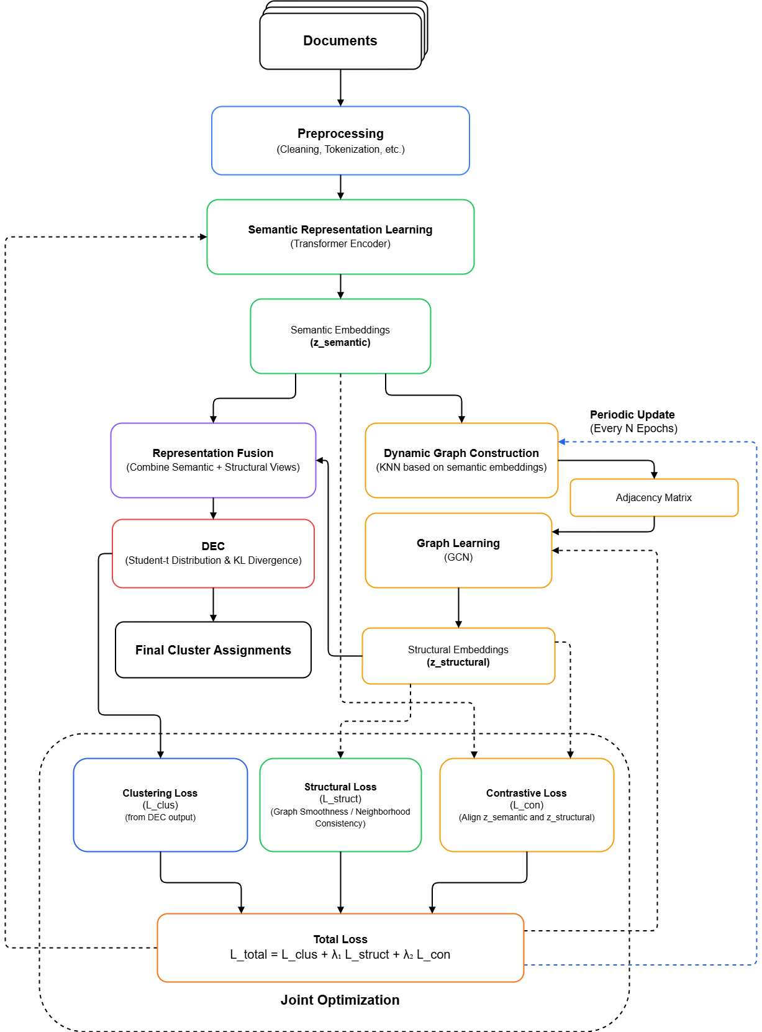
Proposed Methodology

Slide 7
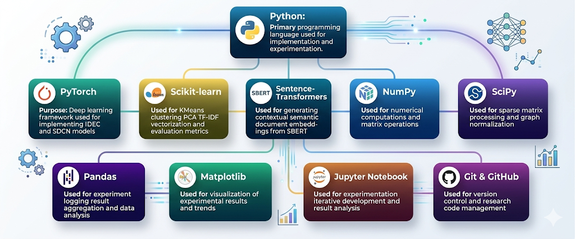
Tools and Technologies

Slide 8
Progress to Date
✔️
Pipelines Configured: Both TF-IDF and dense SBERT contextual embedding pipelines are fully operational.
Clustering Frameworks Built: KMeans, IDEC, and SDCN deep clustering frameworks are implemented.
Structural Mechanics Completed: KNN graph construction (cosine similarity) and sparse adjacency normalization processes are finalized.
Evaluation Engine Finalized: Automated experiment logging and metric tracking (ACC, NMI, ARI, Purity)active across benchmark datasets (AGNews, BBC News, Reuters, 20-Newsgroups).
✔️
✔️
✔️

Slide 9
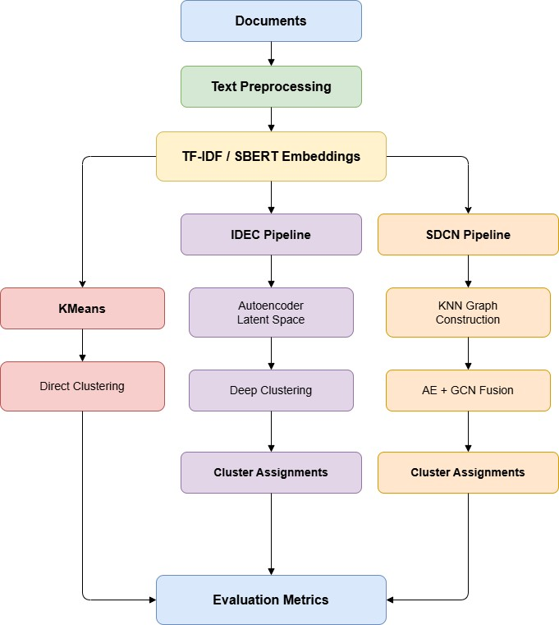
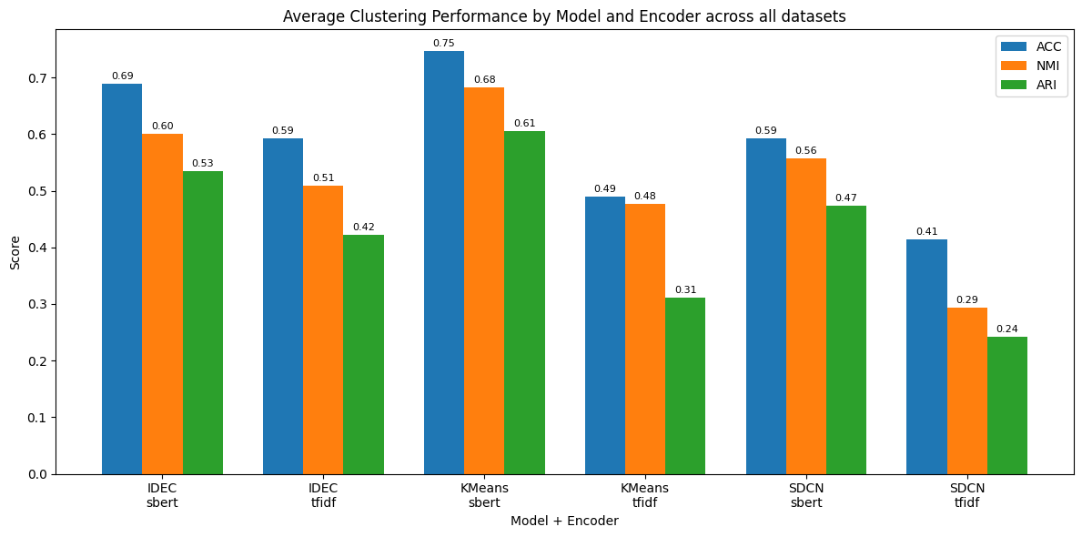
Flow & Findings
Encoder | ACC | NMI | ARI | Purity
SBERT | 0.6763 | 0.6135 | 0.538 | 0.7482
TF-IDF | 0.4989 | 0.4265 | 0.3253 | 0.5797
Model | ACC | NMI | ARI | Purity
IDEC | 0.6407 | 0.5545 | 0.4783 | 0.7277
KMeans | 0.6184 | 0.5799 | 0.4587 | 0.6955
SDCN | 0.5036 | 0.4256 | 0.3578 | 0.5686

Slide 10
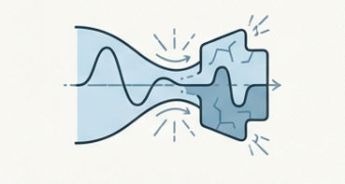
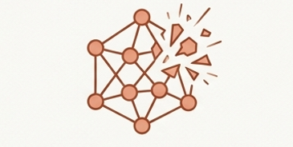

Current Challenges
Multi-objective deep clustering architectures (IDEC, SDCN) did not consistently out perform the simpler KMeans approach on dense SBERT embeddings. Why?
Semantic Distortion
Latent compression in standard autoencoders distorts the already high quality dense contextual embeddings provided by pretrained Transformers.
Graph Sensitivity
Graph-based clustering proved extremely fragile when exposed to fixed KNN configurations, particularly on large, heterogeneous datasets like 20-Newsgroups.
Optimization Instability
Multi-objective optimization remains highly sensitive to initial graph construction and centroid initialization, propagating noise rather than signal.

Slide 11
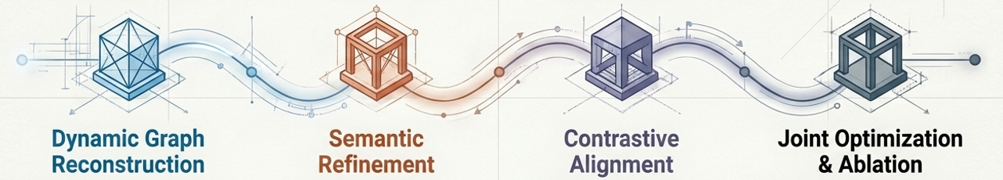
MS Thesis-II Goals
Conclusion: Static graphs and weak alignment actively harm deep clustering. Adaptive mechanisms are strictly required.
Implement mechanisms to periodically rebuild the KNN graph during training to capture evolving semantic realities.
Introduce active Transformer-guided semantic refinement directly into the clustering optimization loop.
Introduce specific contrastive learning objectives to mathematically lock semantic embeddings with graph-based structural embeddings.
Finalize the unified loss framework
(Lclus + Lstruct +Lcon)
and conduct rigorous ablation studies across all benchmark datasets.

Slide 12
Thank You

